Slide 1
Test Case Management in Jira (Zephyr)
Focused on understanding the workflow and navigation of test case management in Jira

Slide 2
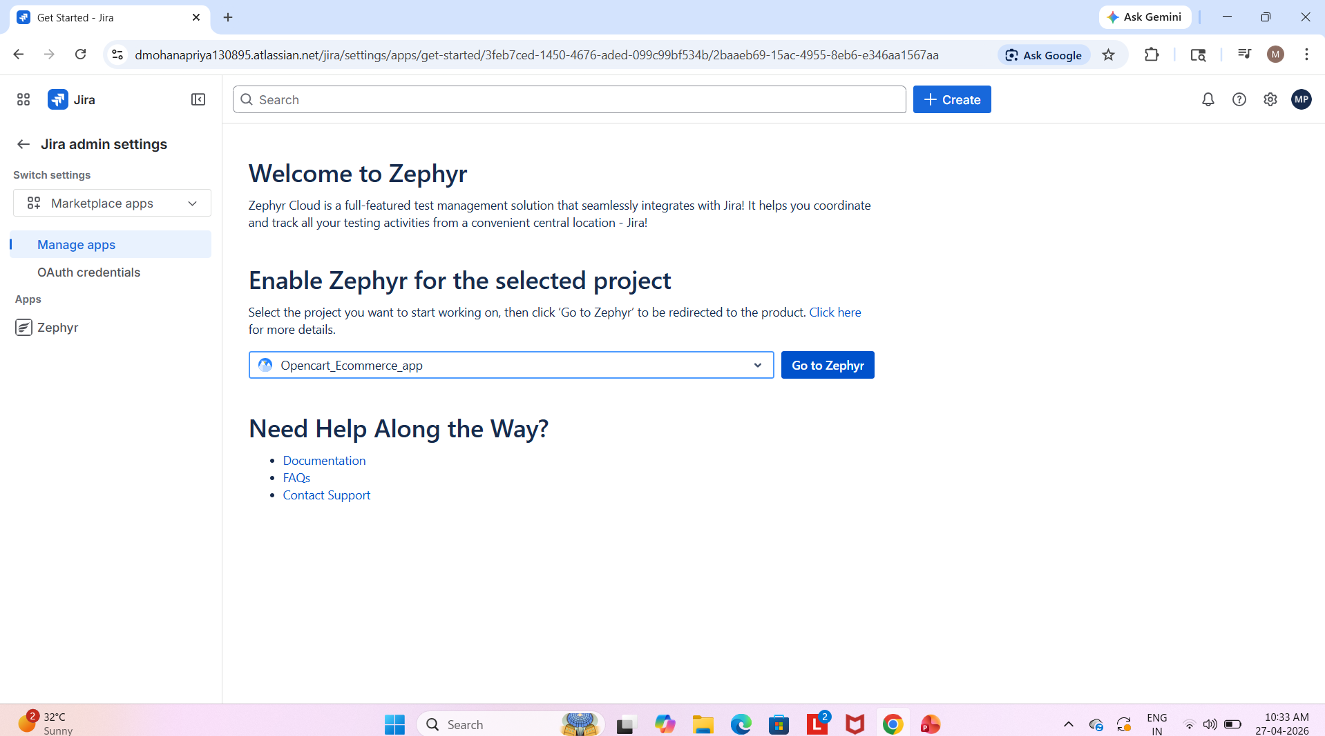
Zephyr Setup in Jira – Selecting Project

Slide 3
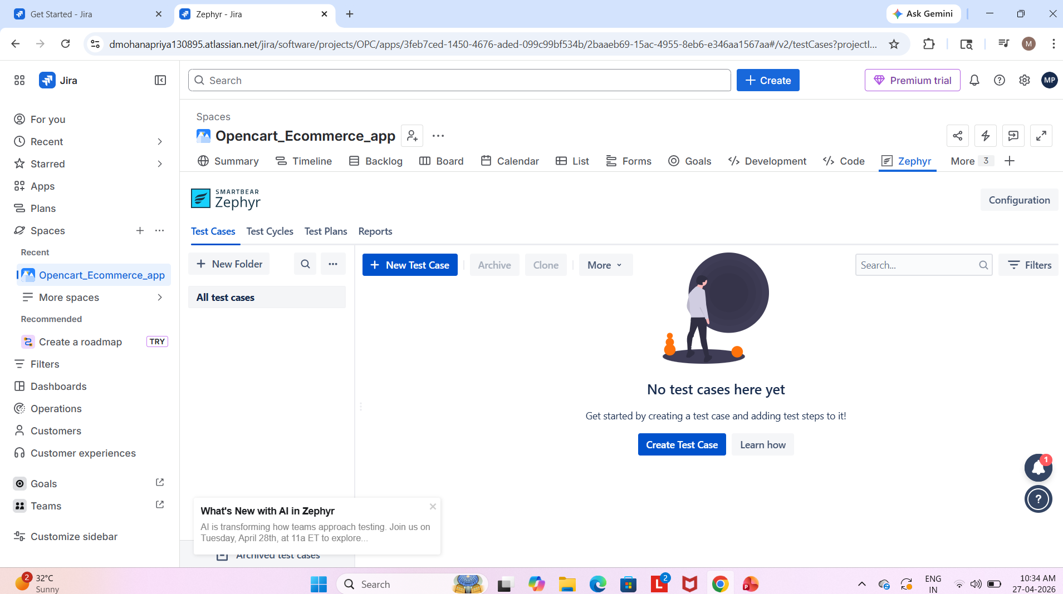
Creating Test Cases in Jira (Zephyr)

Slide 4
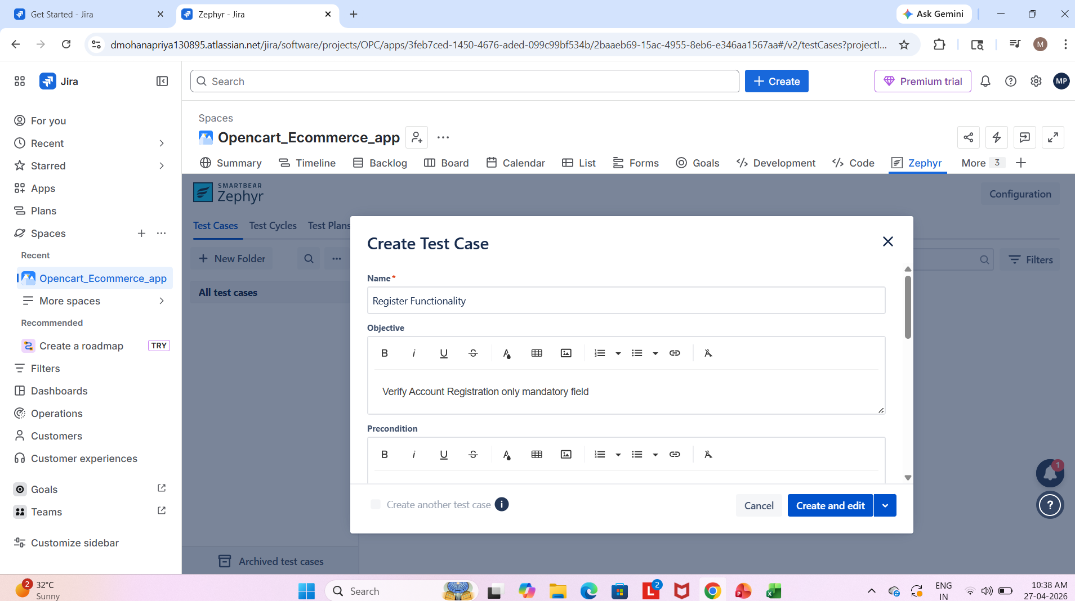
Writing a Test Case – Registration Functionality

Slide 5
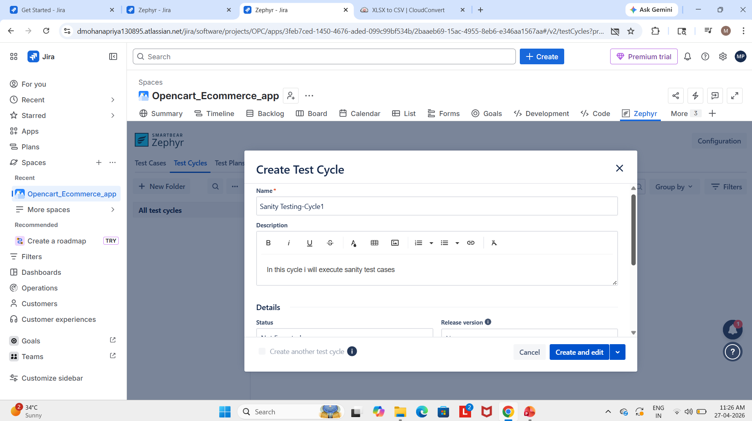
Test Cycle Creation

Slide 6
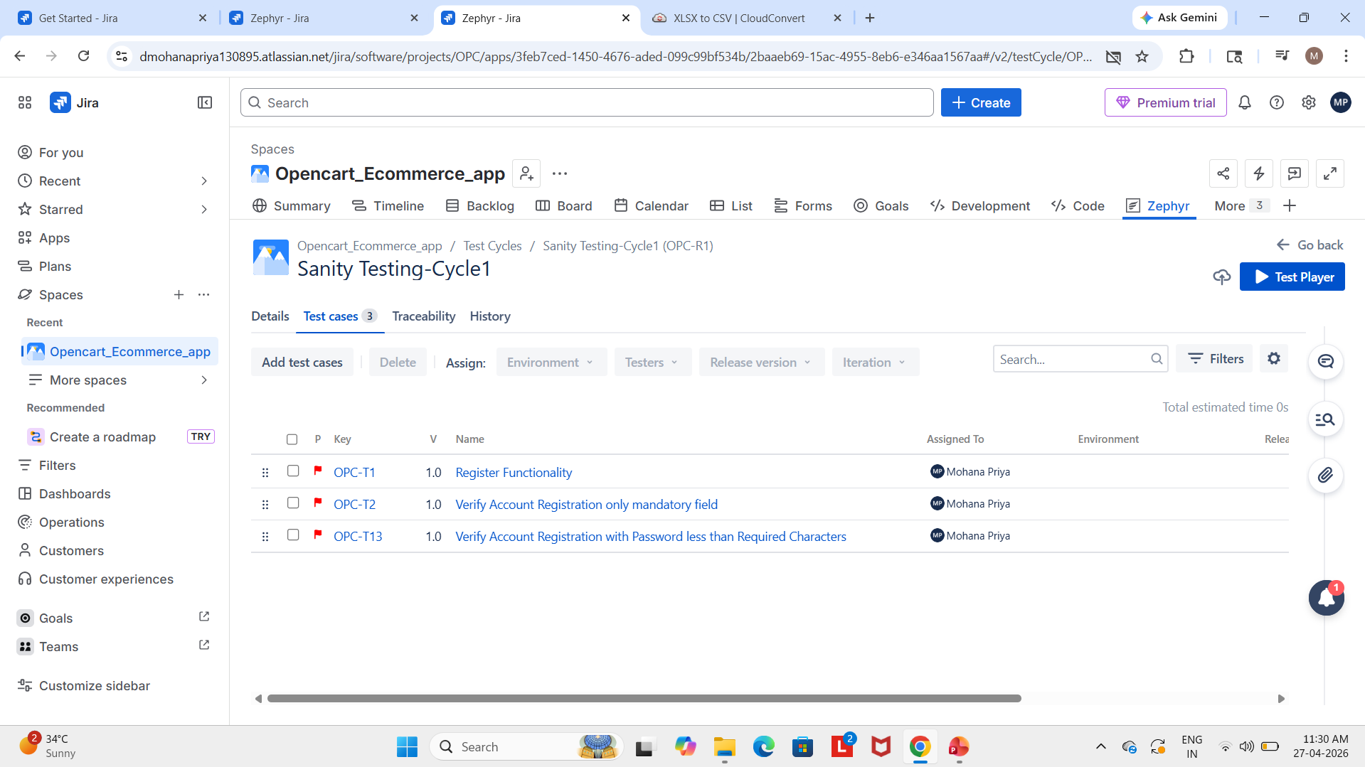

Slide 7
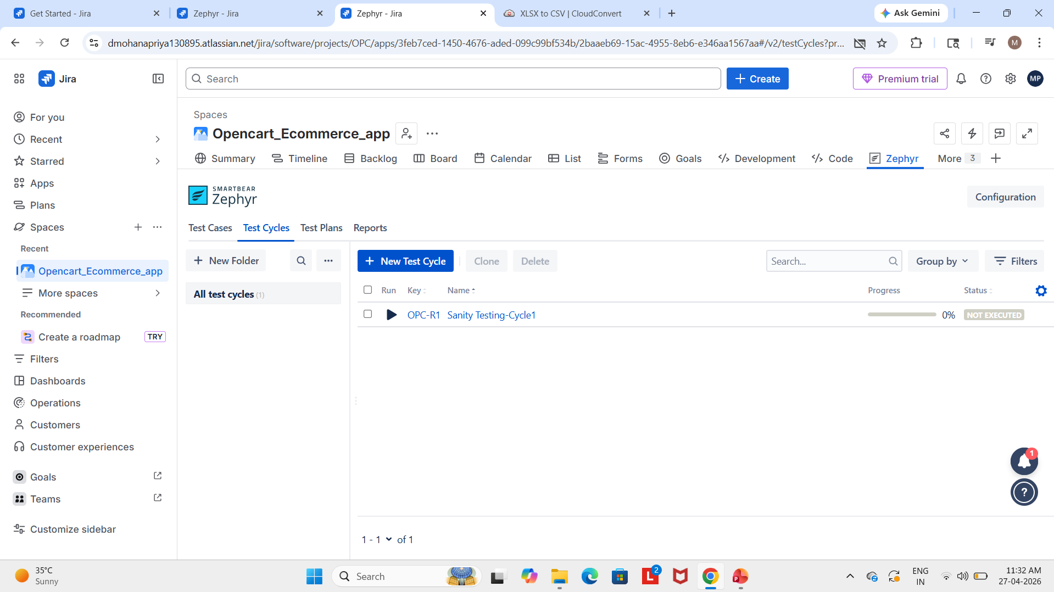

Slide 8
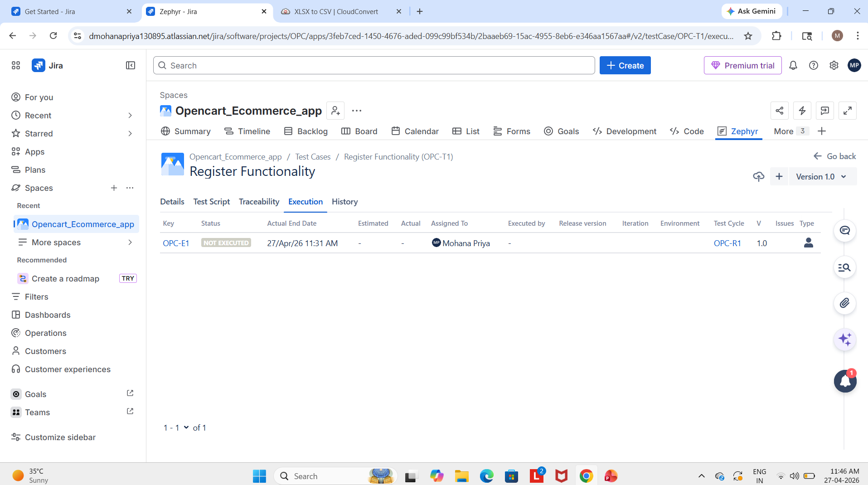
Test Cycle Execution

Slide 9
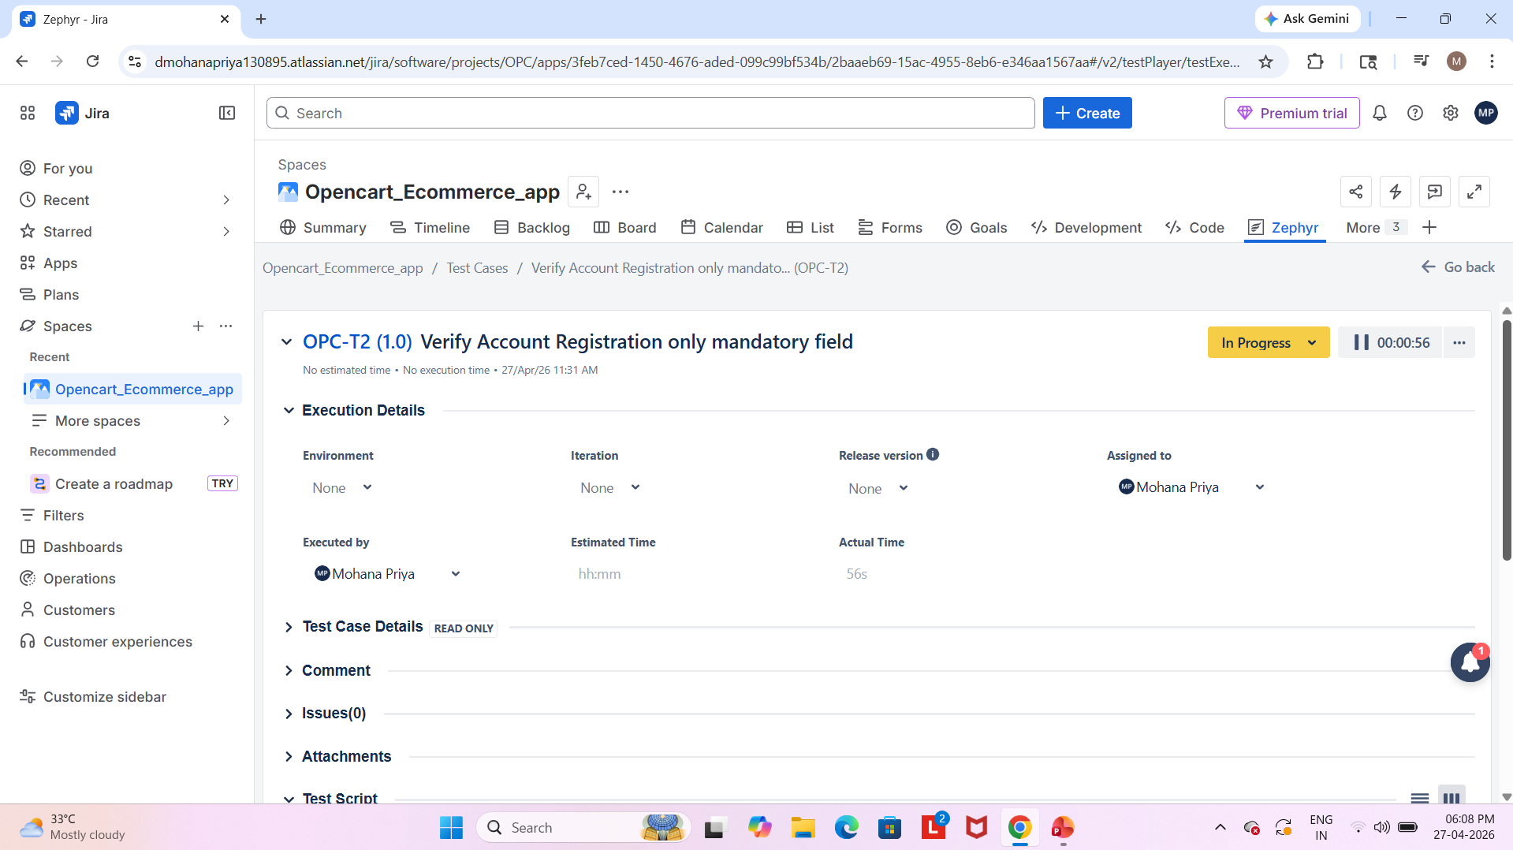

Slide 10
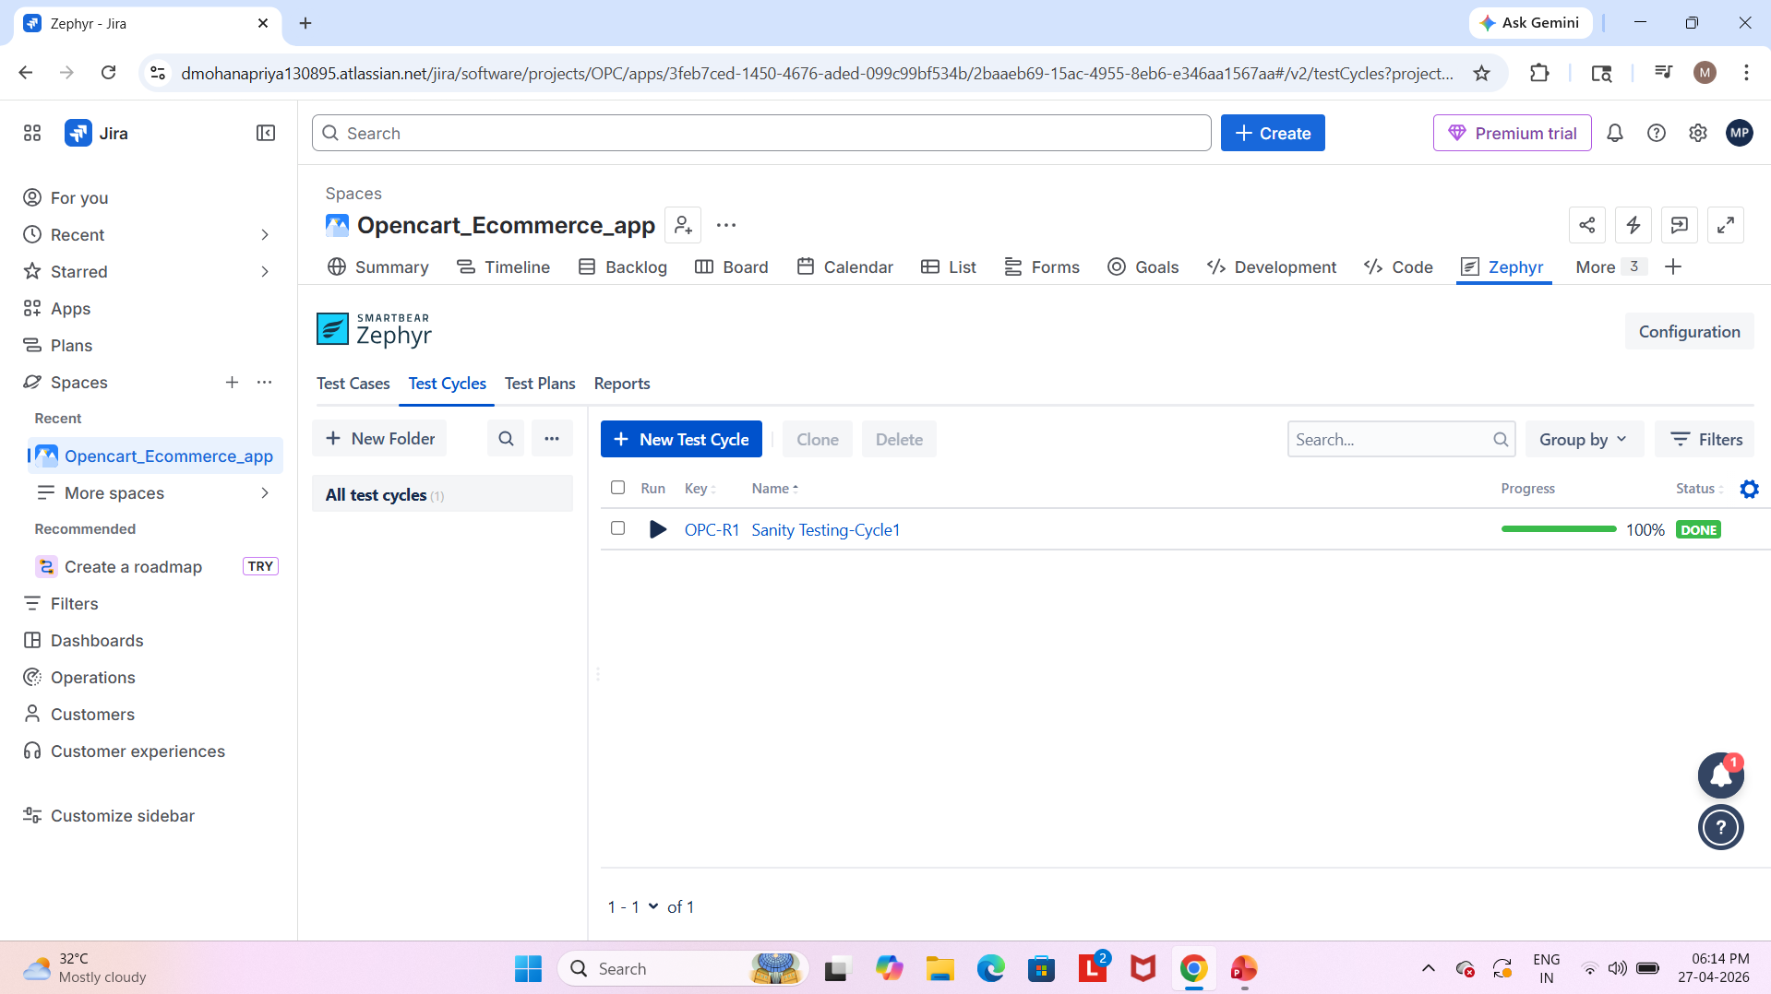

Slide 11
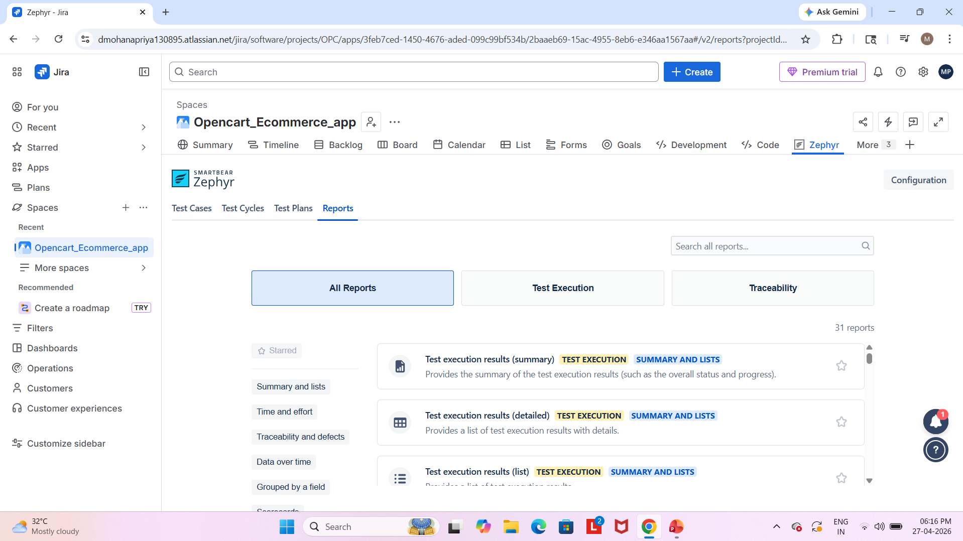
Generating Test Reports

Slide 12
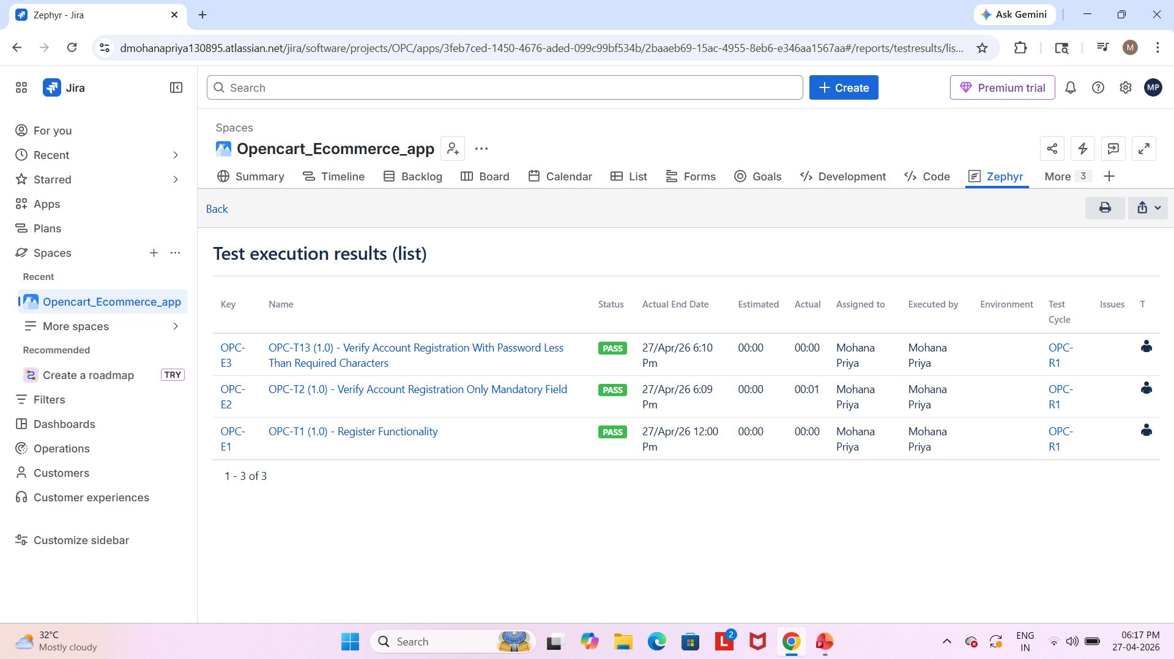
Test Execution Results Overview

